Slide 1





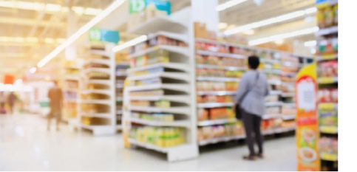




FOR RETAIL
(Grocery)
A large supermarket chain reduces energy procurement costs through peak reduction in refrigeration assets’ energy usage across multiple stores
Benefits
Energy Cost savings
Measurement and Verification
Reporting capabilities
THE CHALLENGE
A large supermarket chain needed urgent data collection and reporting on an active project to balance load on refrigeration units at peak time across multiple stores in order to demonstrate savings to their energy supplier and to access a more preferential energy tariff.
The work required the delivery of validation data rapidly and in an accessible format
THE SOLUTION
Honeywell Enacto was already collecting granular energy consumption data at refrigeration asset level for the stores taking part in the project. The supermarket team leveraged the professional capabilities of the Enacto Managed Services team to quickly develop a tailored set of analytics to confidently demonstrate the project impact on energy consumption at time interval level for each relevant site into a report meaningful to both the supermarket and the energy supplier.
THE OUTCOME
New analytics clearly demonstrated:
Refrigeration energy optimisation during peak early evening demand to exceed the 25% target across the 280 stores taking part in the program – representing a consumption reduction of circa 3MW.
Identification of stores needing further improvements.
Enacto
Energy
Management
platform

